Slide 1
Upperline Code
Functions

Slide 2
What Is A Function?
A function is a group of instructions that performs a certain task.
Example:
CIRCLE_UP() | DRAW_SQUARE()
Stand up. Push in chair. Turn toward the circle area. While not at the circle area: Move forward. Face the teacher. | Repeat 4 times: Move forward 20 pixels. Turn right 90 degrees.

Slide 3
How To Use Functions?
1) Define the Function – These blocks of code lay out each of the steps – one line of code at a time - the overall action the function is supposed to perform.
2) Call the Function – Write the function name to execute the code inside the function.

Slide 4
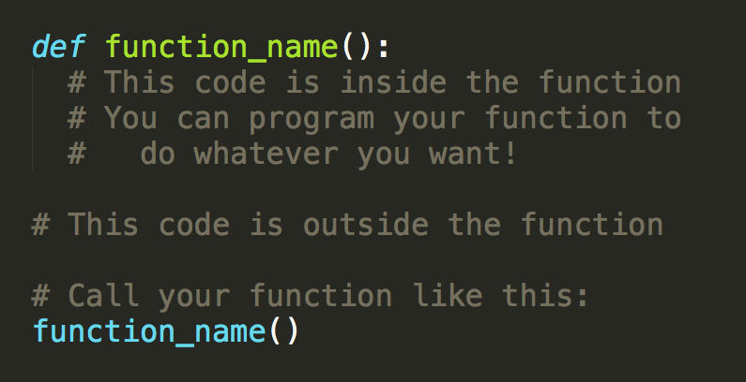
Why Use Functions?
You can define your own functions to do what you want!

Slide 5
Functions In Python
You’ve (probably, hopefully) already seen Python functions!
print() #used to display statements
range() #used typically in for loops
These functions are built-in inside the Python programming language

Slide 6
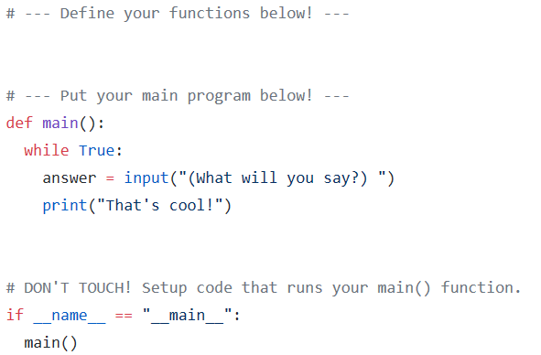
Practice: Define And Call Your Own Functions
Take a look at the code. Can you guess what will happen when you run it?
Run it via the command line. What does it do?

Slide 7
Practice: Define And Call Your Own Functions
Write a function so that the program introduces itself to the user before it starts asking for input.

Slide 8
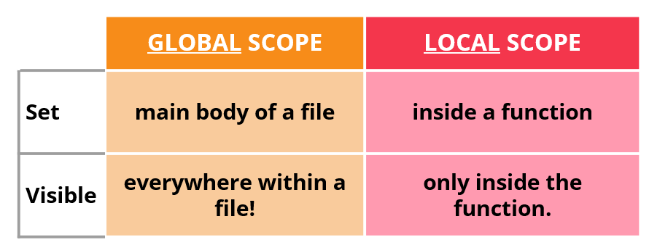
What is Scope?
Scope is the part of a program where a particular variable is visible.

Slide 9
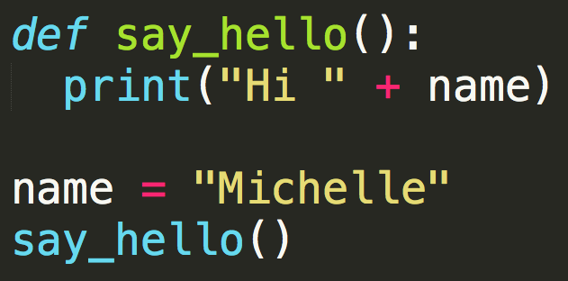
Scope - Examples
The variable, name: is it a global variable or a local variable? Why?
What will happen when this code runs?

Slide 10
Global Variables
Global variables are considered bad programming practice!
Hard to tell which function(s) are reading/writing to a variable
Harder to reuse code across programs
Avoid using global variables whenever possible!!

Slide 11
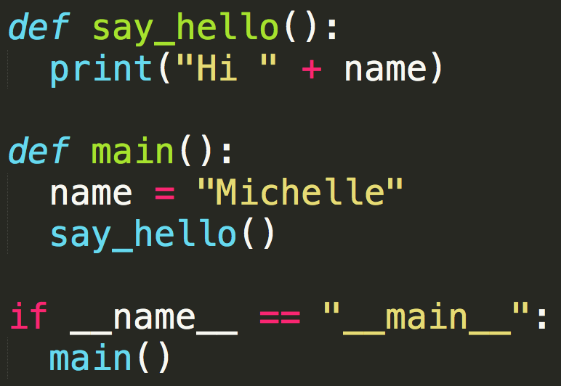
Scope - Examples
The variable, name: is it a global variable or a local variable? Why?
What will happen when this code runs?
Notes:
The program will crash with a NameError: "name 'name' is not defined."

Slide 12
What Do We Do?
Global variables are bad practice.
Local variables give NameErrors.
Next: Introduce Parameters…

